Slide 1
Functions in Python
Reusable blocks of code that can take in a return data

Slide 2
Learning Outcomes
Define a function and explain its purpose
Write and call simple functions with parameters and return values
Understand local vs. global scope
Identify common pitfalls (missing return, indentation)

Slide 3
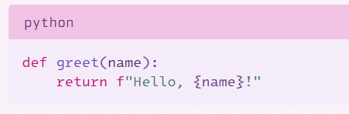
What is a function
A named block of code that performs a task and can be reused
Key parts:
name,
parameters (inputs),
body,
return (output)
Visual: high-level block diagram (name -> [params] -> body -> return)

Slide 4
Parameters vs. Arguments
Definitions:
Parameter: name in the function
Argument: value you pass when calling the function
Print(greet(“John”))

Slide 5
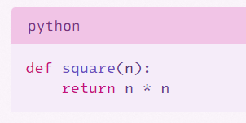
Return Statement
Purpose
To send a value back to the caller
What will happen if there is no return in the function?
If no return, function returns None

Slide 6
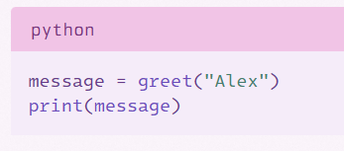
Calling a function
There are a couple of ways a function can be called

Slide 7
Local vs Global scope
Definition
Global – A variable defined outside the function
Local – A variable defined inside the function
Try to avoid using global variables inside a function. Can cause confusion when debugging

Slide 8
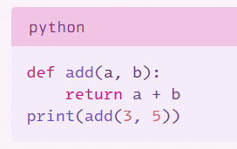
Quick Practice
Predict the outcome of this function
Create this function to confirm prediction

Slide 9
Quick Challenge
Create a function to convert C to F
Formula: F = C * 9/5 + 32
print(c_to_f(0)) # 32
print(c_to_f(100)) # 212
What if you want multiple outputs?

Slide 10
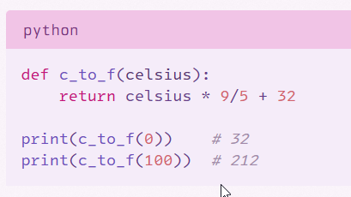
Solution

Slide 11
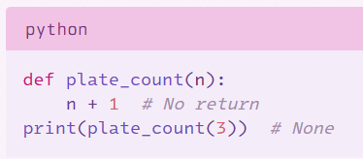
Common pitfalls
Missing Return
Indentation Errors
Calling the wrong number of arguments

Slide 12
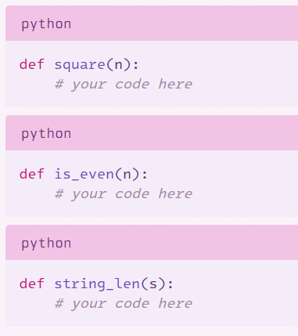
Quick Practice
3 Functions are to be created
Work in pairs
1 – Create the square of a number
2 – Is the entered number even
3 – Find the length of an entered string

Slide 13
Function Summary
What a function is
Defining and calling a function
Returning a value
Basic pitfalls

